Slide 1
Zen of Data
Lesson 1.1

Slide 2

Notes:
Have every student in class introduce themselves. Feel free to refer to the slides or come up with questions of your own. Try to keep things lighthearted as students share their backgrounds.
When all students have had a chance to introduce themselves, have the TAs introduce themselves as well.
Finally, introduce yourself and showcase a project or two to demonstrate your chops in the data field.

Slide 3
The Rise of Data

Slide 4
Why is data analytics such a hot skill these days?

Slide 5

Explosive Growth in Digitized Data (Creation)
1
Notes:
Explain that there has been an explosion of digital data in recent years.

Slide 6

Explosive Growth in Analytic Tools (Synthesis)
2
Notes:
Explain that there are now more robust tools to analyze this data explosion.

Slide 7
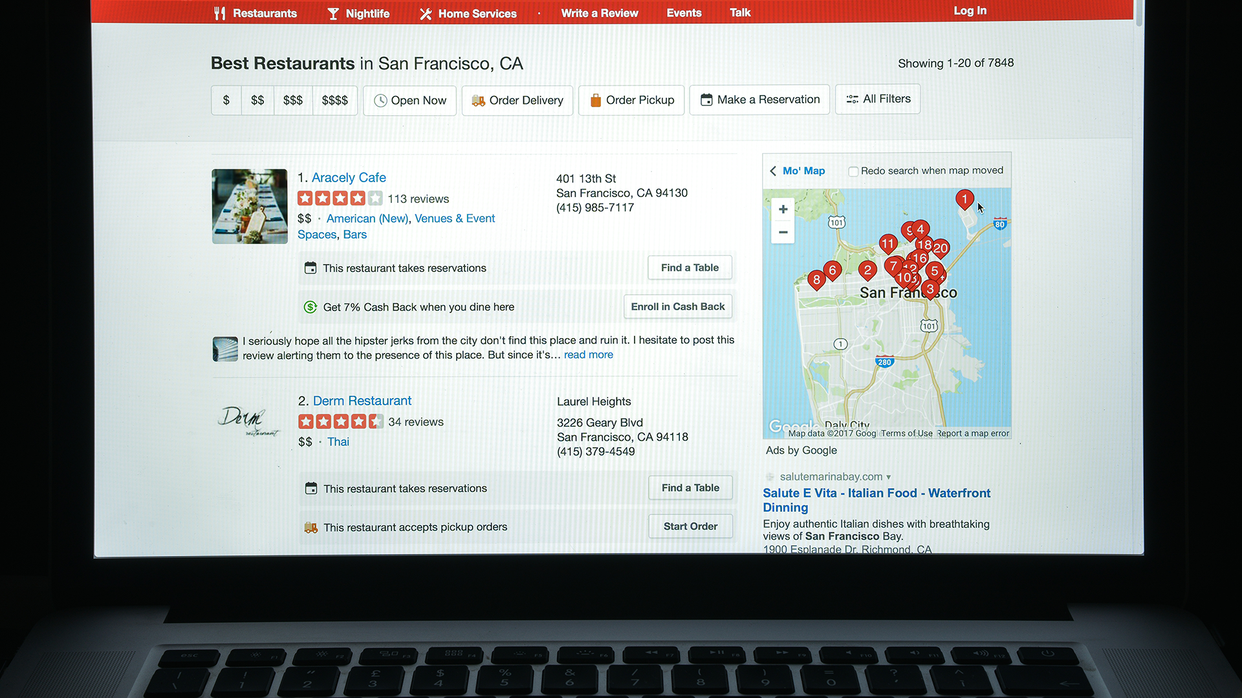
Accelerating Search for Actionable Insight (Value)
3
Notes:
Explain that there is increasing recognition among business and industry leaders that data can drive business value.
Ask the students to think of examples of using data to add business value.

Slide 8

What does the term data mean?
Notes:
Start the next section by asking students to define the term data science. Ask them what they think of when they hear the term data science.
Direct students to break off into pairs and take a minute to discuss their definitions with each other.
After a minute or two, call on a few students to share their answers.

Slide 9

Perhaps you are picturing an Excel spreadsheet.

Slide 10

Data Science Involves Spreadsheets and Formulas

Slide 11
Fundamentally, data science is about storytelling and truth-telling.
Notes:
Data professionals often focus on numbers and tools but lose sight of what really matters: trying to understand a phenomenon and then communicating one's findings.

Slide 12
Data as Storytelling

Slide 13
Data as Storytelling
U.S. Debt as Percentage of Gross Domestic Product, 1790–2011
1790 | 29,6% | 1835 | 0.0 | 1880 | 18.4 | 1925 | 21.6 |  | 1970 | 28.0
1791 | 29.2 | 1836 | 0,0 | 1881 | 16.8 | 1926 | 19.0 |  | 1971 | 28.1
1792 | 28.0 | 1837 | 0.2 | 1882 | 14.3 | 1927 | 18.0 |  | 1972 | 27.4
1793 | 24.4 | 1838 | 0.6 | 1883 | 13.5 | 1928 | 17.0 |  | 1973 | 26.0
1794 | 21.8 | 1839 | 0.2 | 1884 | 13.3 | 1929 | 14.9 |  | 1974 | 23.9
1795 | 18.7 | 1840 | 0.3 | 1885 | 13.2 | 1930 | 16.5 |  | 1975 | 25.3
1796 | 16.4 | 1841 | 0.8 | 1886 | 12.4 | 1931 | 22.3 |  | 1976 | 27.5
1797 | 16.5 | 1842 | 1.2 | 1887 | 11.2 | 1932 | 34.5 |  | 1977 | 27.8
1798 | 16.0 | 1843 | 1.5 | 1888 | 10.2 | 1933 | 39.1 |  | 1978 | 27.4
1799 | 15.8 | 1844 | 1.0 | 1889 | 8.6 | 1934 | 44.0 |  | 1979 | 25.6
1800 | 15.1 | 1845 | 0.7 | 1890 | 7.8 | 1935 | 42.9 |  | 1980 | 26.1
1801 | 13.3 | 1846 | 1.2 | 1891 | 7.0 | 1936 | 43.0 |  | 1981 | 25.8
1802 | 13.9 | 1847 | 1.7 | 1892 | 6.6 | 1937 | 40.1 |  | 1982 | 28.7
1803 | 14.1 | 1848 | 2.2 | 1893 | 6.8 | 1938 | 42.8 |  | 1983 | 33.1
1804 | 13.2 | 1849 | 2.5 | 1894 | 7.9 | 1939 | 43.0 |  | 1984 | 34.0
1805 | 10.9 | 1850 | 2.3 | 1895 | 7.9 | 1940 | 42.7 |  | 1985 | 26.4
1806 | 10.0 | 1851 | 2.4 | 1896 | 8.5 | 1941 | 43.3 |  | 1986 | 38.5
The Great Depression & World War II
Reagan Tax Cuts
Data: Congressional Budget Office
Notes:
Explain that data analytics involves storytelling because it requires analysts and scientists to capture a narrative based on a set of data.

Slide 14
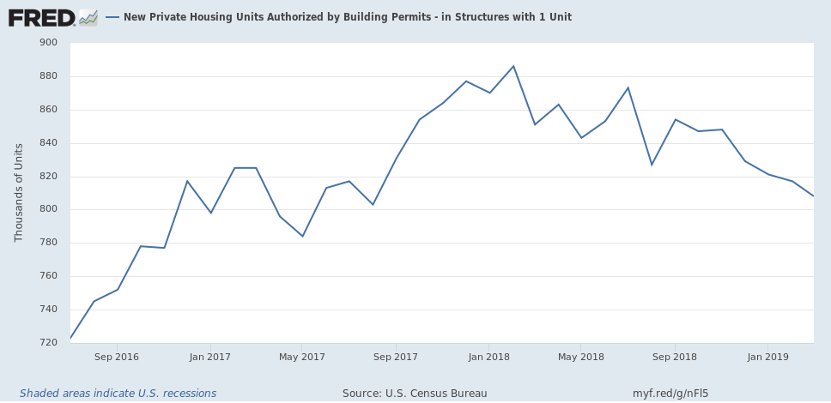
Data = Drama
New Housing Construction: Making A Bottom, At Close To Recessionary Levels
https://seekingalpha.com
Notes:
Explain that every data problem has a beginning, middle, and end. It's important to capture that story and be able to communicate it to others.

Slide 15
Data as Truth-Telling

Slide 16
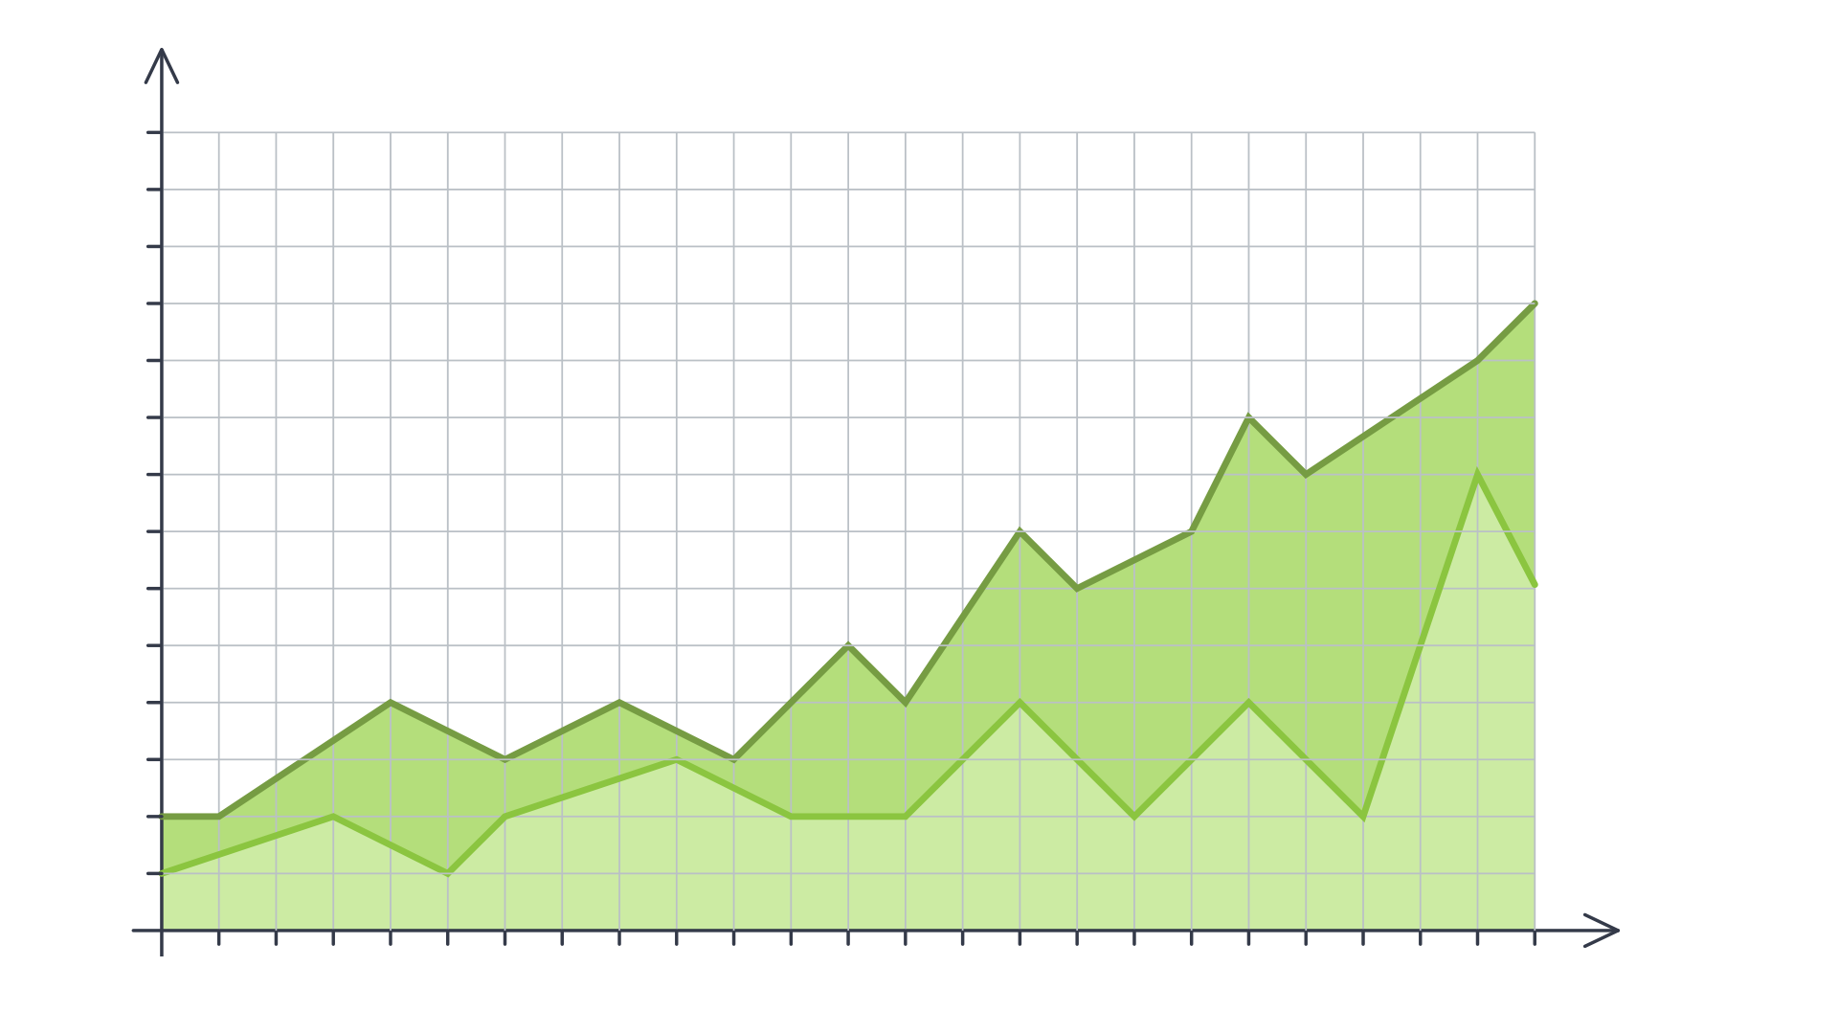


Data as Truth-Telling
Unearthing Relationships
Lung Cancer Deaths per 100,000
100k
95k
80k
85k
80k
75k
70k
65k
60k
55k
50k
45k
40k
35k
30k
25k
20k
1900
1901
1902
1903
1904
1905
1906
1907
1908
1909
1909
1910
1911
1912
1913
1914
1915
1916
1917
1918
1919
1920
Lung Cancer Deaths
Cigarettes Smoked
Notes:
Explain that data analytics also involves truth-telling because it requires analysts to understand the world as it is. This analysis is commonly referred to as a “retrospective analysis”.

Slide 17

Data as Truth-Telling
Making Predictions
Notes:
Explain that analysts are also tasked with predicting the world as it could be. This analysis is commonly referred to as a “modelling”.

Slide 18
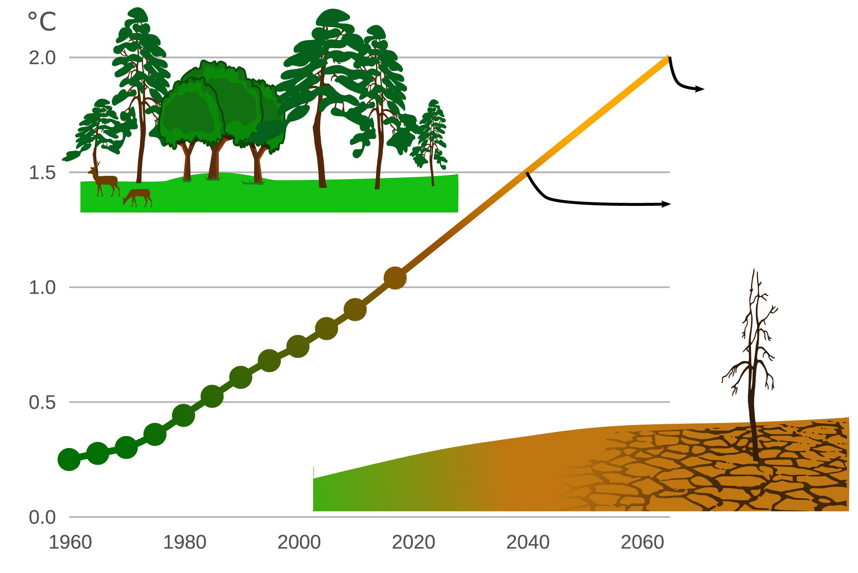
Data as Truth-Telling
Stating Significance
Exposure to Extreme Drought Is Increasing
190 million people
114 million people
Notes:
Explain that data analysts need to distinguish between what's true and what's false, using data to make these determinations.

Slide 19
Course Overview

Slide 20



Tools for Truths, Skills for Stories:
Our Goals:
Our Means:
Microsoft Excel
Python
pandas
Matplotlib/Seaborn
APIs
Beautiful Soup
Machine Learning
SQL
MongoDB
HTML/CSS
JavaScript
D3.js
Leaflet.js/Google Maps
Tableau
Hadoop
Truth-telling
Storytelling
Notes:
Explain that contrary to what many believe, data analytics and data science are not exact sciences, and there isn't a linear pathway to becoming a data professional. Being a good data analyst requires being well versed in a variety of tools, technologies, approaches, and strategic processes.
Tell students that this course will provide significant exposure to a variety of data tools, strategies, processes, and technology to build their tool belt.
Ask students how many have heard of each technology. For example, "How many of you have heard of or worked with pandas?" "How many of you have heard of worked with MongoDB?"
Explain to students that these technologies account for four buckets in data science:
Programming languages
Statistical methods
Data storage and retrieval
Reporting capabilities

Slide 21
Course Overview
Each class will include the following:
Overview of Lesson Topics
Instructor Lecture
Instructor Demonstration
Class Discussions
In-Class Activities
Project Work
Notes:
Read through the slide and describe each activity type

Slide 22
Weekly Breakdown by Subject

Slide 23
Weeks 1–2
Intro to Data Analytics & Excel Masters: Introduction to the high-level concepts of data analytics and real-world data crunching with Excel formulas, pivot tables, and conditional formatting.
Week 1
Week 2
Week 3
Week 4
Week 5
Week 6
Week 7
Week 8
Week 9
Week 10
Week 11
Week 12
Week 13
Week 14
Week 15
Week 16
Week 17
Week 18
Week 19
Week 20
Week 21
Week 22
Week 23
Week 24
Python Data Analytics and Visualization: Thorough crash course on Python programming, followed by multiple weeks of data processing using advanced libraries like NumPy, pandas, Matplotlib, Seaborn, and Beautiful Soup.
Deep Dive into Databases: Immersion into introductory and advanced work with SQL (PostgreSQL) and noSQL databases (MongoDB).
Web-Based Data Visualization: Introduction to the fundamental tools of web development (HTML, CSS, JavaScript) and advanced libraries that are useful for data visualization (D3.js, Leaflet.js).
Final Projects & Advanced Topics: Introduction to Tableau and R as well as advanced topics like Hadoop and Machine Learning. Develop a real-world data visualization project.
Notes:
Walk through each highlighted section with the class

Slide 24
Weeks 3–9
Week 1
Week 2
Week 3
Week 4
Week 5
Week 6
Week 7
Week 8
Week 9
Week 10
Week 11
Week 12
Week 13
Week 14
Week 15
Week 16
Week 17
Week 18
Week 19
Week 20
Week 21
Week 22
Week 23
Week 24
Intro to Data Analytics & Excel Masters: Introduction to the high-level concepts of data analytics and real-world data crunching with Excel formulas, pivot tables, and conditional formatting.
Python Data Analytics and Visualization: Thorough crash course on Python programming, followed by multiple weeks of data processing using advanced libraries like NumPy, pandas, Matplotlib, Seaborn, and Beautiful Soup.
Deep Dive into Databases: Immersion into introductory and advanced work with SQL (PostgreSQL) and noSQL databases (MongoDB).
Web-Based Data Visualization: Introduction to the fundamental tools of web development (HTML, CSS, JavaScript) and advanced libraries that are useful for data visualization (D3.js, Leaflet.js).
Final Projects & Advanced Topics: Introduction to Tableau and R as well as advanced topics like Hadoop and Machine Learning. Develop a real-world data visualization project.
Notes:
Walk through each highlighted section with the class

Slide 25
Weeks 10–12
Week 1
Week 2
Week 3
Week 4
Week 5
Week 6
Week 7
Week 8
Week 9
Week 10
Week 11
Week 12
Week 13
Week 14
Week 15
Week 16
Week 17
Week 18
Week 19
Week 20
Week 21
Week 22
Week 23
Week 24
Intro to Data Analytics & Excel Masters: Introduction to the high-level concepts of data analytics and real-world data crunching with Excel formulas, pivot tables, and conditional formatting.
Python Data Analytics and Visualization: Thorough crash course on Python programming, followed by multiple weeks of data processing using advanced libraries like NumPy, pandas, Matplotlib, Seaborn, and Beautiful Soup.
Deep Dive into Databases: Immersion into introductory and advanced work with SQL (PostgreSQL) and noSQL databases (MongoDB).
Web-Based Data Visualization: Introduction to the fundamental tools of web development (HTML, CSS, JavaScript) and advanced libraries that are useful for data visualization (D3.js, Leaflet.js).
Final Projects & Advanced Topics: Introduction to Tableau and R as well as advanced topics like Hadoop and Machine Learning. Develop a real-world data visualization project.
Notes:
Walk through each highlighted section with the class

Slide 26
Weeks 13–17
Week 1
Week 2
Week 3
Week 4
Week 5
Week 6
Week 7
Week 8
Week 9
Week 10
Week 11
Week 12
Week 13
Week 14
Week 15
Week 16
Week 17
Week 18
Week 19
Week 20
Week 21
Week 22
Week 23
Week 24
Intro to Data Analytics & Excel Masters: Introduction to the high-level concepts of data analytics and real-world data crunching with Excel formulas, pivot tables, and conditional formatting.
Python Data Analytics and Visualization: Thorough crash course on Python programming, followed by multiple weeks of data processing using advanced libraries like NumPy, pandas, Matplotlib, Seaborn, and Beautiful Soup.
Deep Dive into Databases: Immersion into introductory and advanced work with SQL (PostgreSQL) and noSQL databases (MongoDB).
Web-Based Data Visualization: Introduction to the fundamental tools of web development (HTML, CSS, JavaScript) and advanced libraries that are useful for data visualization (D3.js, Leaflet.js).
Final Projects & Advanced Topics: Introduction to Tableau and R as well as advanced topics like Hadoop and Machine Learning. Develop a real-world data visualization project.
Notes:
Walk through each highlighted section with the class

Slide 27
Weeks 18–24
Week 1
Week 2
Week 3
Week 4
Week 5
Week 6
Week 7
Week 8
Week 9
Week 10
Week 11
Week 12
Week 13
Week 14
Week 15
Week 16
Week 17
Week 18
Week 19
Week 20
Week 21
Week 22
Week 23
Week 24
Intro to Data Analytics & Excel Masters: Introduction to the high-level concepts of data analytics and real-world data crunching with Excel formulas, pivot tables, and conditional formatting.
Python Data Analytics and Visualization: Thorough crash course on Python programming, followed by multiple weeks of data processing using advanced libraries like NumPy, pandas, Matplotlib, Seaborn, and Beautiful Soup.
Deep Dive into Databases: Immersion into introductory and advanced work with SQL (PostgreSQL) and noSQL databases (MongoDB).
Web-Based Data Visualization: Introduction to the fundamental tools of web development (HTML, CSS, JavaScript) and advanced libraries that are useful for data visualization (D3.js, Leaflet.js).
Final Projects & Advanced Topics: Introduction Tableau and R as well as advanced topics like Hadoop and Machine Learning. Develop a real-world data visualization project.
Notes:
Walk through each highlighted section with the class

Slide 28
Example Activity

Slide 29
Example Activity: Banking Deserts
In this activity, you will use a variety of public demographic data and APIs to explain many real-world social phenomena. Utilize data from sources like the U.S. Census, Google Maps, and more to find insights on poverty, discrimination, and the impact of changing economies.
20 minutes
Notes:
Explain that throughout the course we will have a number of hands-on activities in each class. This is just an example of one of the hands-on activities.
Before moving on, acknowledge that the course will cover a lot of material. The goal is to learn how to break down complex, seemingly insoluble problems; doing so requires a clear understanding of how data works and what it can do.

Slide 30
Helpful Tips

Slide 31

Embrace your inner toddler.
Notes:
Emphasize that a beginner's mindset will help students roll up their sleeves and invest the time necessary to succeed.
Explain that for many of us, coding is like nothing else we have ever done before.

Slide 32

Brace yourself for doubt, challenge, and confusion.
Notes:
Explain that mastery of other subjects, educational backgrounds, and professional achievements do not guarantee success in this course. The only things that will guarantee success are hard work, humility, and a relentless desire to improve. Recognizing how little you know is the first step toward success.
Learning how to analyze data can be tough, intimidating, and frustrating. And it's hard. It will take time; there's no way around that. Accepting this fact helps us stay motivated.

Slide 33

There is no shortcut.
You’ve got to put in the hours!
Notes:
shutterstock_643629568

Slide 34

Form a community with your classmates.
Notes:
Explain that challenges are bound to arise over the coming months. Encourage students to lean on each other for support, and to remember that we're all embarking on this journey together.

Slide 35

Relish the novice experience and expect a lot of lightbulb moments.
Notes:
Remind them that you were once in their shoes. They have what it takes, which is why they're in the program in the first place.

Slide 36

Celebrate your successes!
Notes:
Explain that by the end of the curriculum you will be amazed how much more you know about data science, data visualization and statistics than you do right now!

Slide 37
Group Activity:
Form groups of 3 or 4 people. Introduce yourself to your group.
Get up from your seats and walk around.
Don’t be shy!
10 minutes

Slide 39
Group Activity:
The Great Debate
Find your group you formed before the break. Together ponder the following question.
20 minutes

Slide 40
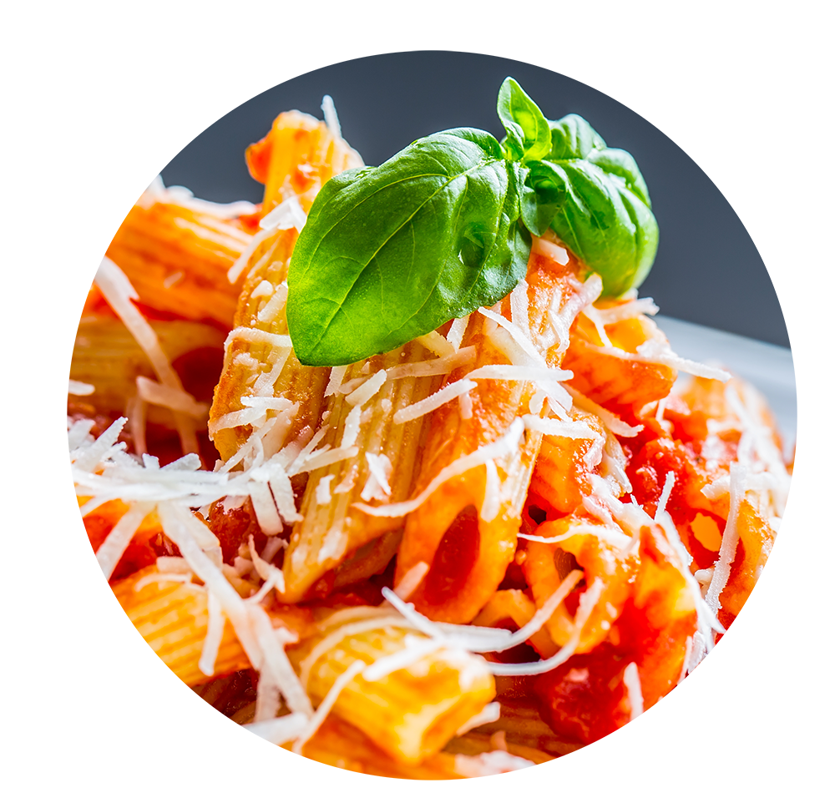
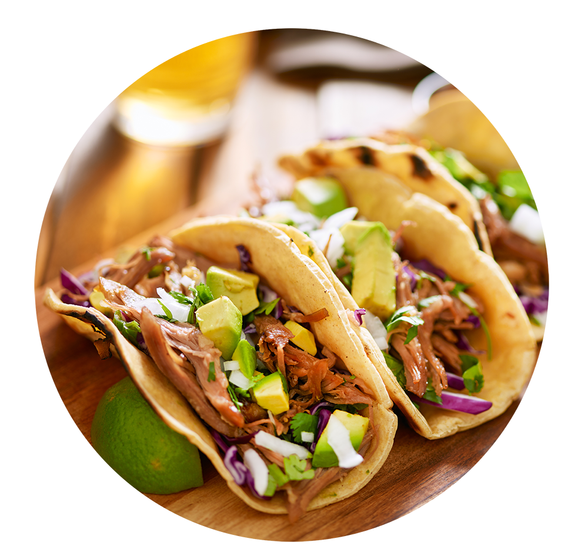
Group Activity: The Great Debate
Which do Americans prefer:
Italian or Mexican food?
Notes:
Tell students that this thought experiment focuses on this question: "Which do Americans prefer: Italian food or Mexican food?" The task is to develop a strategy for answering this question in 10 hours or less, using data.

Slide 41

Group Activity: The Great Debate
Suggested Time: 20 minutes
With your group, develop a strategy for answering this question with as much confidence possible. Specifically, answer questions like:
Assumptions:
You are given 5 hours and a budget of $10 to accomplish this.
Your answer will be tested by randomly selecting 9 Americans who will each be asked the question—with 0 qualifiers.
You only have your team.
What data will you attempt to gather?
What relationships will you be looking for?
How will you ensure your answer is most likely “true”?
Notes:
Acknowledge that the premise of the question might seem silly, but it's actually a great learning experiment because it forces students to ask questions such as:
What does it mean to prefer?
What data can be used to determine preference?
How do we ensure that all Americans are represented?
If you need to get students to take the assignment more seriously, try raising the stakes with scenarios like:
You are up for a promotion and your entire promotion rests on answering this question.
You are advising a restaurateur who is about to invest millions in a franchising opportunity. She needs to know which type of cuisine to invest in.

Slide 42
The Great Debate (Analyzed)

Slide 43
Step 1: Decompose the “Ask”
Notes:
Explain that the first step is to break down the question into its smaller parts (Americans, prefer, Mexican, Italian) in order to determine a set of quantifiable proxies.

Slide 44
Step 1: Decompose the “Ask”
Which do Americans prefer:
Italian or Mexican food?
Notes:
Point out that Americans must be inclusive of both urban and rural locations, as well as inclusive of the full American population.

Slide 45
Step 1: Decompose the “Ask”
Which do Americans prefer: Italian or Mexican food?
Who exactly is an American?
Are Americans just homeowners?
Do Americans just live in big cities?
Are Americans just millennials?
Notes:
Point out the other questions that can better define the ask (seen above)

Slide 46
How can we get a representative sample of Americans?
Notes:
Ask the students of some ideas how to retrieve a good representative sample of all Americans.

Slide 47
Step 1: Decompose the “Ask”
Which do Americans prefer:
Italian or Mexican food?
Notes:
Point out that preference can be measured by the number of people who visit Mexican restaurants vs. Italian restaurants, and the overall sentiments people express upon visiting those restaurants.

Slide 48
Step 1: Decompose the “Ask”
Which do Americans prefer: Italian or Mexican food?
How do we define “preference”?
Do people prefer the foods they eat most frequently?
Do people prefer the foods they wish they could eat if cost was not an issue?
How uniform is the preference? Is it regionalized? Is it different by demographic?
Notes:
Point out the other questions that can better define the ask (seen above)

Slide 49
Inherently, preference is subjective. We are going to need to make it objective.

Slide 50
Step 1: Decompose the “Ask”
Which do Americans prefer:
Italian or Mexican food?
Notes:
Explain that now that we have interrogated each subcomponent of the ask we can look at the greater question.

Slide 51
Italian and Mexican are broad categories we are pursuing. We will have to narrow the scope.

Slide 52
Step 1: Decompose the “Ask”
Which do Americans prefer: Italian or Mexican food?
How do we categorize foods? Is pizza Italian? Is Taco Bell Mexican?
How do we categorize food? Does making pasta at home constitute Italian? Or are we just talking about restaurants?
Are we just talking about “best experiences”? Or are we including poorer renditions of these foods?
Notes:
Point out that depending on context, the ask can be interpreted a number of ways. It is important to know your audience as well as to get the full context of what is trying to be asked.
Explain that for this example we are asking generally asking “Do Americans prefer to go to Italian or Mexican restaurants?”

Slide 53
Step 2: Identify Data Sources

Slide 54









Step 2: Identify Data Sources
Why poll an audience when there already exist enormous databases of information about Americans’ food preferences—readily available online?

Slide 55
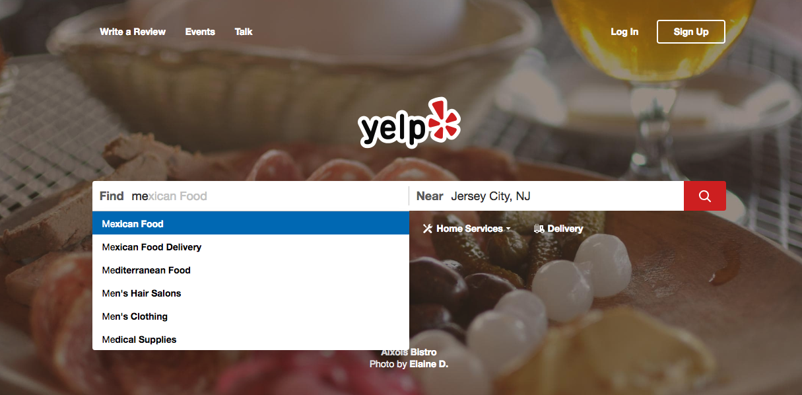
Step 2: Identify Data Sources
As everyday consumers, we are regularly getting a pulse of everyday American food preferences to inform our own decisions. Perhaps we can make use of the same approach.
www.yelp.com
Notes:
Explain that we can use web services like Yelp and Google reviews to look at the number of reviews and average ratings for any number of restaurants in nearly every city in America.

Slide 56
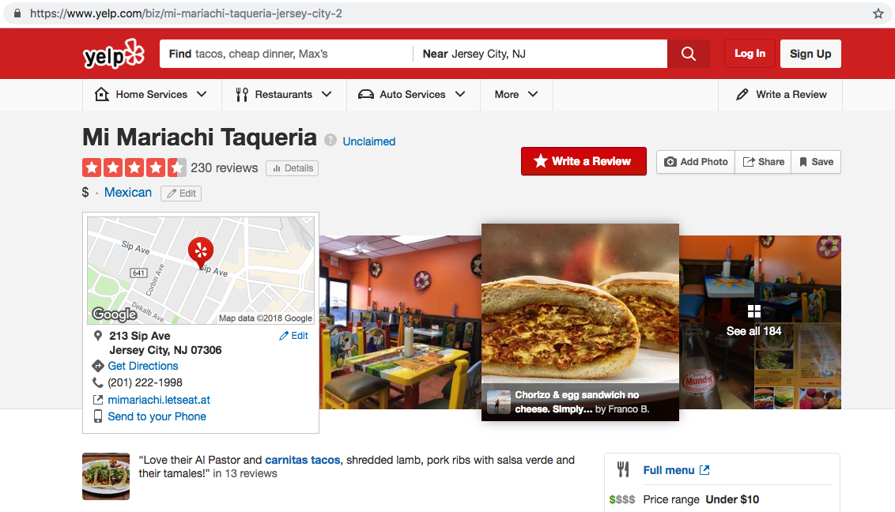
Step 2: Identify Data Sources
Web services like Yelp provide an almost encyclopedic amount of information about the eating preferences of Americans.
www.yelp.com
Notes:
Propose to the students that we can obtain random of zip codes from the U.S. census to get a representative sample.
Explain that once we have our zip codes, we can query each location through Yelp.

Slide 57
Step 3: Define Strategy and Metrics

Slide 58
Step 3: Define Strategy and Metrics
Here we created a blueprint for what we’re targeting:
Americans:
Ideally, we need thousands of records from Americans in hundreds of different cities. (Large samples)
Preference:
Number of Yelp Reviews (More = Preference)
Average Aggregated Ratings (Higher = Preference)
Italian and Mexican Food:
Top 20 Italian and Mexican restaurants in every city
Notes:
Explain to the students that we would need to query at least 500 zip codes to get an adequate representation of the continental US. So for this example, we are going to obtain 700 randomly sampled zip codes from the U.S. census.

Slide 59
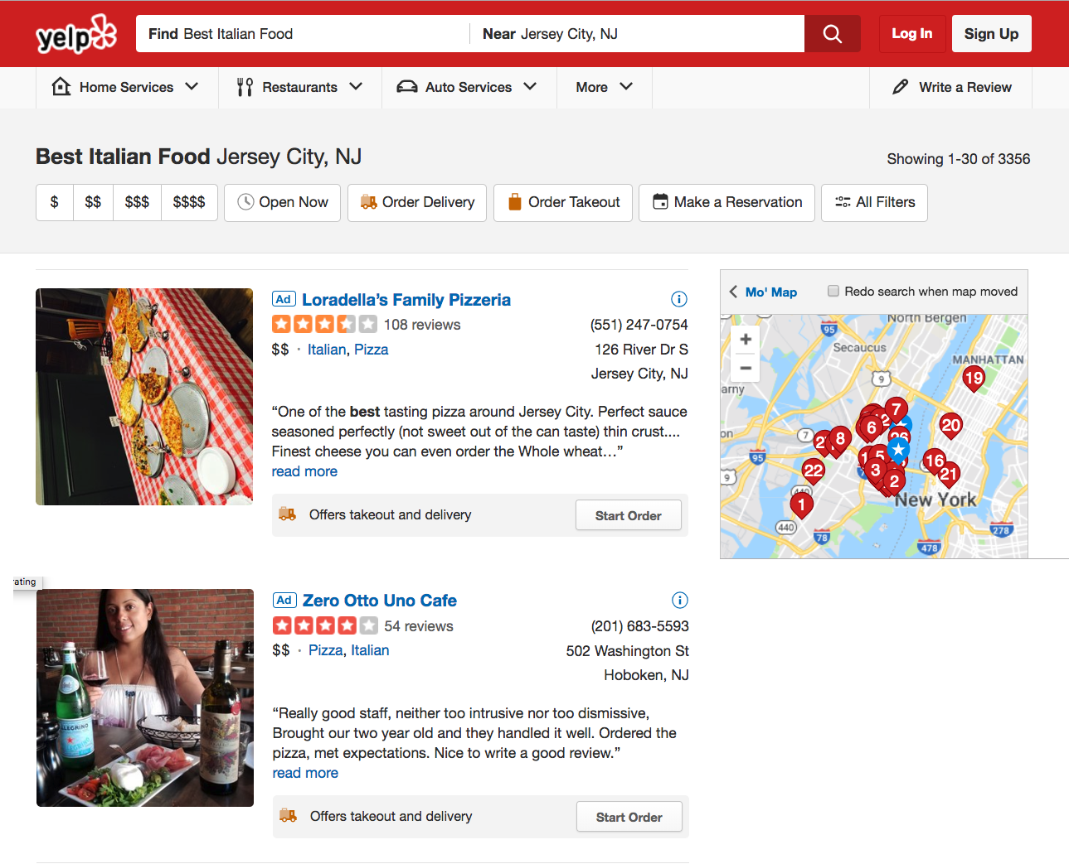

Step 3: Define Strategy and Metrics
Food Type
Lots of Data!
Review Count
Locations
Rating
www.yelp.com
Notes:
Explain that for our proposed analysis we will tally the total number of reviews and average rating for the top 20 Mexican and Italian restaurants in each zip code.

Slide 60
Step 3: Define Strategy and Metrics
Repeat this analysis for as many cities as possible.
New York, NY
Italian | Mexican
Restaurant | Restaurant
Restaurant | Restaurant
Restaurant | Restaurant
Restaurant | Restaurant
Restaurant | Restaurant
Tucson, AZ
Italian | Mexican
Restaurant | Restaurant
Restaurant | Restaurant
Restaurant | Restaurant
Restaurant | Restaurant
Restaurant | Restaurant
Washington, D.C.
Italian | Mexican
Restaurant | Restaurant
Restaurant | Restaurant
Restaurant | Restaurant
Restaurant | Restaurant
Restaurant | Restaurant
VS.
VS.
VS.
Omaha, NE
Italian | Mexican
Restaurant | Restaurant
Restaurant | Restaurant
Restaurant | Restaurant
Restaurant | Restaurant
Restaurant | Restaurant
San Diego, CA
Italian | Mexican
Restaurant | Restaurant
Restaurant | Restaurant
Restaurant | Restaurant
Restaurant | Restaurant
Restaurant | Restaurant
Atlanta, GA
Italian | Mexican
Restaurant | Restaurant
Restaurant | Restaurant
Restaurant | Restaurant
Restaurant | Restaurant
Restaurant | Restaurant
VS.
VS.
VS.
Notes:
Explain that this is a visual representation of the analysis we will perform

Slide 61
Step 4: Build Data Retrieval Plan

Slide 62
Step 4: Build Data Retrieval Plan
We could retrieve this data by brute force, but it would be:
Extremely time consuming
Skewed by our city familiarity
Labor intensive
Mexican
New York, NY
Mexican
Denver, CO
Mexican
Oklahoma City, OK
www.yelp.com
Notes:
Remind the students that there are a lot of different types of data and metadata that can be retrieved by Yelp for each zip code. Unfortunately, it would be prohibitively expensive and time-consuming to manually retrieve and store the results of 700 zip codes.

Slide 63
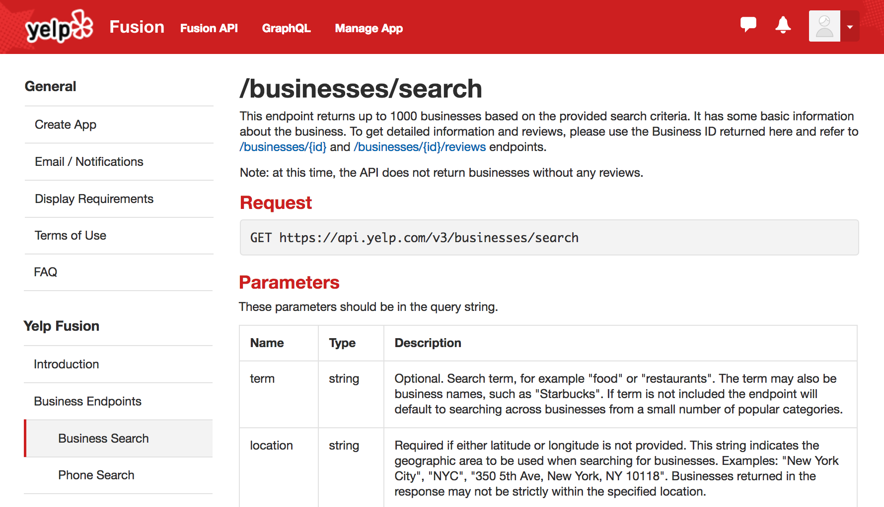
Thank You, Yelp!
Thankfully, we can take advantage of the Yelp Fusion API to programmatically run our queries. (#ThankGoodnessForProgramming)
www.yelp.com
Notes:
Explain that thankfully we can use Yelp’s API collect and store the data set for each zip code programmatically.

Slide 64
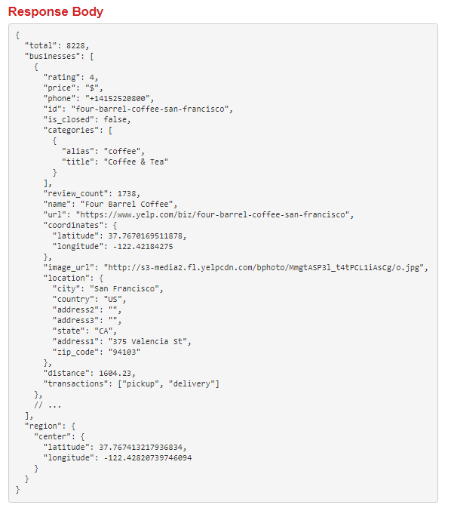

Thank You, Yelp!
www.yelp.com
Notes:
Explain that this is the output from a Yelp API query. It may look really busy and intimidating right now, but we have tools to make sense of this output.

Slide 65



Step 4: Build Data Retrieval Plan
We will build a Python script to randomly select over 700 zip codes from the U.S. Census, and then acquire review data from the top 20 Mexican and Italian restaurants for each zip code using the Yelp API.
11101
Italian | Mexican
Restaurant | Restaurant
Restaurant | Restaurant
Restaurant | Restaurant
Restaurant | Restaurant
Restaurant | Restaurant
07360
Italian | Mexican
Restaurant | Restaurant
Restaurant | Restaurant
Restaurant | Restaurant
Restaurant | Restaurant
Restaurant | Restaurant
20001
Italian | Mexican
Restaurant | Restaurant
Restaurant | Restaurant
Restaurant | Restaurant
Restaurant | Restaurant
Restaurant | Restaurant
68007
Italian | Mexican
Restaurant | Restaurant
Restaurant | Restaurant
Restaurant | Restaurant
Restaurant | Restaurant
Restaurant | Restaurant
22434
Italian | Mexican
Restaurant | Restaurant
Restaurant | Restaurant
Restaurant | Restaurant
Restaurant | Restaurant
Restaurant | Restaurant
30301
Italian | Mexican
Restaurant | Restaurant
Restaurant | Restaurant
Restaurant | Restaurant
Restaurant | Restaurant
Restaurant | Restaurant
www.yelp.com
Notes:
Explain that by using Python, we can parse the Yelp API output into a more table-like format. Once we have a more table-like output, we are free to analyze the data and draw conclusions!

Slide 66
Step 5: Retrieve the Data

Slide 67
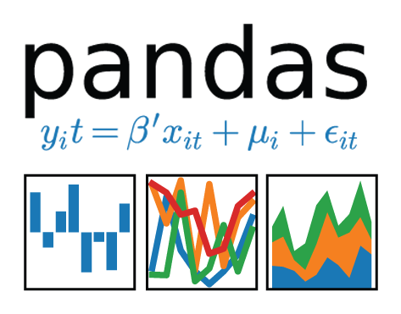
Pulling with Python
Randomly Select a Zip Code
Save the Output to a Data Frame
Create an API Request
Notes:
Explain that we can use Python in all steps of data retrieval and generation. Python can obtain a random zip code from the U.S. census, make an API request to Yelp, and store the output into a pandas data frame.

Slide 68
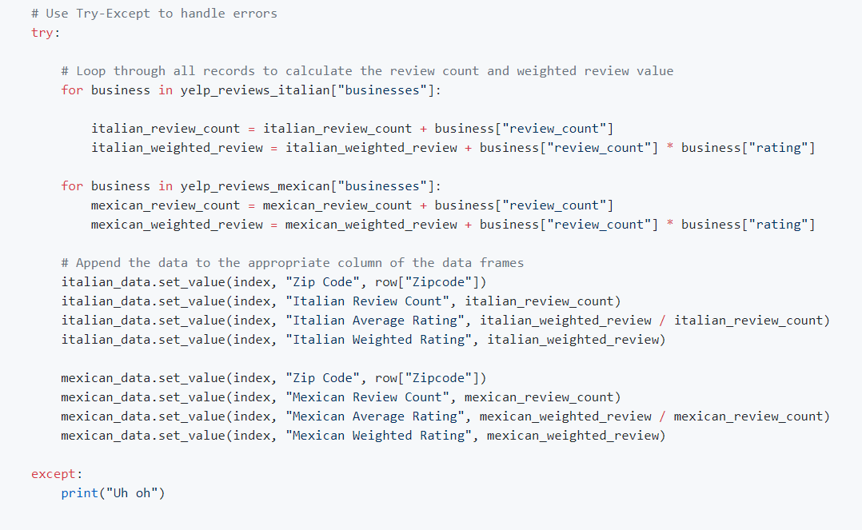
Pulling with Python
This funky code...
Notes:
Explain that this is what the API query looks like in python.

Slide 69
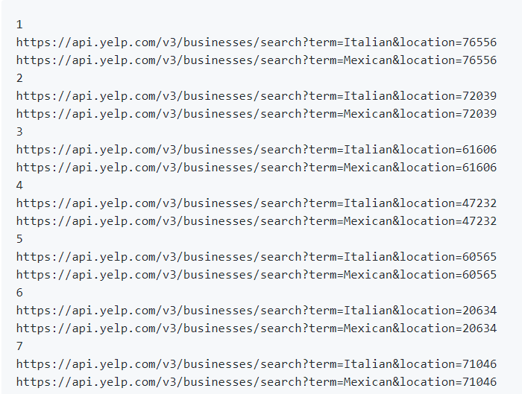
Pulling with Python
...will make all of these URLs.
Notes:
Explain that this calculation is performed in the blink of an eye - magnitudes faster than any human could search on Yelp.

Slide 70
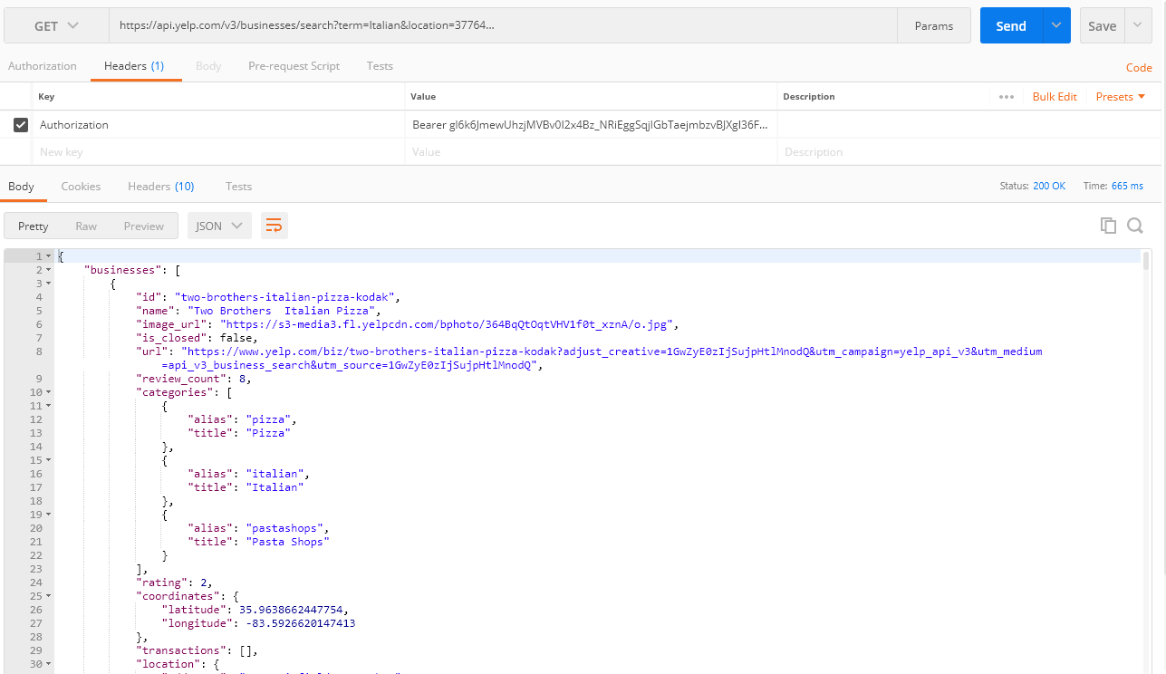
Pulling with Python
Each of these URLs holds a piece of our answer.
Notes:
Explain that once we have our API responses, we need to “scrape” our data of interest from the page. Once again we can use Python to perform this task.

Slide 71
Step 6: Assemble and Clean the Data

Slide 72
Cleaning with Pandas
No data comes out intrinsically the way you want it to.
In our case, we needed multiple steps to aggregate the data along our channels of interest.
# Combine DataFrames into a single DataFrame combined_data = pd.merge(mexican_data, italian_data, on=”Zip Code”) combined_data.head( )
 | Zip Code | Mexican Review Count | Mexican Average Rating | Mexican Weighted Rating | Italian Review Count | Italian Average Rating | Italian Weighted Rating
0 | 76556 | 97 | 4.1134 | 399 | 63 | 3.78571 | 238.5
1 | 72039 | 256 | 4.11133 | 1052.2 | 266 | 3.81955 | 1016
2 | 61606 | 378 | 3.64286 | 1377 | 66 | 3.2197 | 212.5
3 | 47232 | 222 | 4.16892 | 925.5 | 420 | 3.77857 | 1587
4 | 60565 | 2842 | 3.94053 | 11199 | 2829 | 3.92824 | 11113
Notes:
Explain that pandas is a super powerful package in Python that is used for storing, manipulating, cleaning and analyzing data.
Explain for this example we would use pandas to clean and assemble the data to show comparative information such as overall average rating, total number of reviews, and the number of cities in which one cuisine had a higher rating than the other.

Slide 73
Step 7: Analyze for Trends

Slide 74
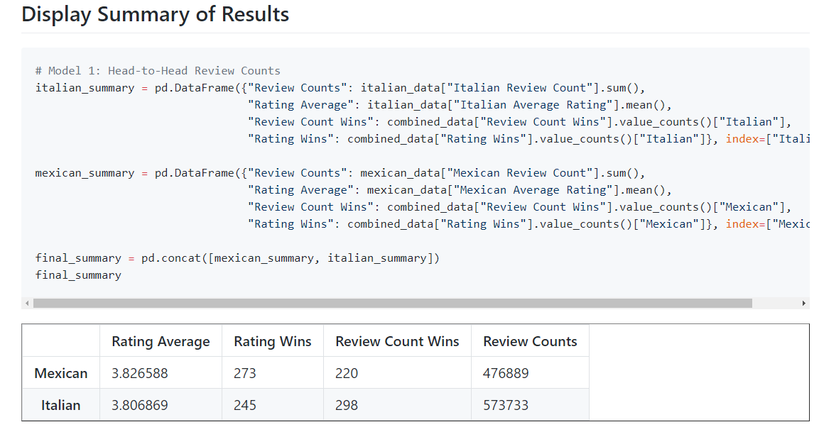
Analyze for Trends (Table)
It’s Close:
Notes:
Explain that for our example, we could compare head-to-head the average rating, the number of wins, and the number of reviews.
Explain that once we have finished analyzing the data, we need to build visualizations to help tell the story.

Slide 75
Analyze for Trends (Ratings)
Yelpers rate Italian and Mexican relatively equally.
4.0
3.5
3.0
2.5
2.0
1.5
1.0
0.5
0.0 | Mexican | Italian
Yelp Ratings by Food Variety
=
Average Rating
Food Variety
www.yelp.com
Notes:
Point out to the students that visualizations can be really helpful to convey a message quickly.

Slide 76
Analyze for Trends (Ratings)
Yelpers seem to significantly review more Italian restaurants.
Yelp Ratings by Food Variety
600000
500000
400000
300000
200000
100000
0.0 | Mexican | Italian
Review Counts
Food Variety
www.yelp.com
Notes:
Explain that visualizations can also help us to generate a hypothesis which we can test using statistics.

Slide 77
Analyze for Trends (Statistical Analysis)
Because of how close the numbers appear, we utilized a Student’s t-test to quickly assess if the perceived differences are not statistically significant but could be considered substantial.
Metric | Italian | Mexican | p-Value (t-test)
Average Rating | 3.806 | 3.826 | 0.284
Review Counts | 573k | 476k | 0.057
The difference in review count is not statistically significant.
Notes:
Ultimately, we find that in the case of Italian vs. Mexican food, the differences are close.
Americans rate Italian and Mexican restaurants roughly the same, but there are more Yelp reviews for Italian restaurants.
This may indicate increased preference, but it may also suggest that people who go to Italian restaurants are more likely to be Yelp reviewers.
Explain that later in the course we will discuss hypothesis testing and statistical tests and how to apply them.

Slide 78
Analyze for Trends (Winner Take All)
Just for kicks, let’s throw in an analysis that aggregates the data from all cities using a winner-take-all approach.
It’s sort of a wash.
 | # of Cities with Preference by Food Variety According to Rating
300
250
200
150
100
50
0 | Mexican | Italian
 | Food Variety
 | # of Cities with Preference by Food Variety According to Review Counts
300
250
200
150
100
50
0 | Mexican | Italian
 | Food Variety
# of Cities
# of Cities
www.yelp.com
Notes:
Recognize that there are a number of other ways we could look at the results of the data set.

Slide 79
Step 8: Acknowledge Limitations

Slide 80
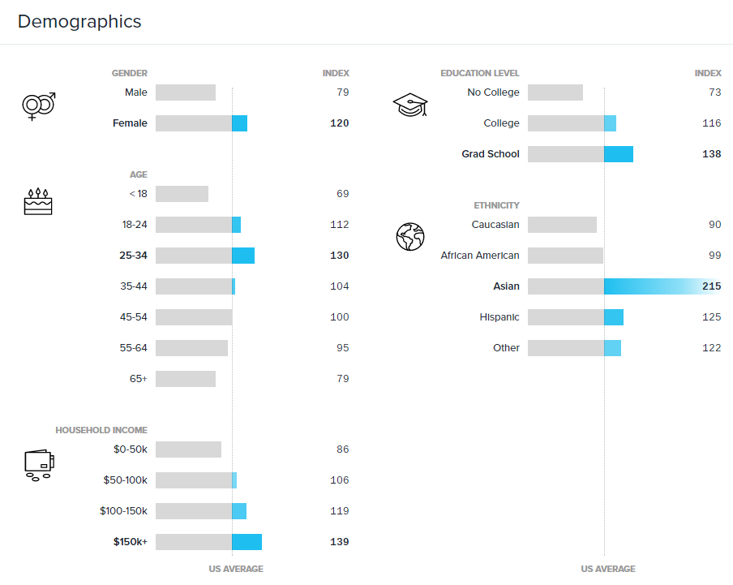
Limitations of Analysis
Yelp demographics may not match the American demographic.
www.yelp.com
Notes:
Explain that identifying factors that could introduce bias is critical when reporting on results.

Slide 81


Limitations of Analysis
Restaurant experiences do not equate to home-cooked meals.
Notes:
Point out that we knew that we had to narrow the scope of the question, so we disregarded any preference to home-cooked foods.

Slide 82

Limitations of Analysis
Fine-dining effect?
Notes:
Point out that there could be a perceived bias that one type of cuisine is fancier than the other, leading to better overall reviews. This perceived fanciness may or may not be correlated to the quality of the food at the restaurant.

Slide 83
Step 9: Make the Call

Slide 84
Making the Call
The “Proper” Conclusion:
Based on our analysis, it’s clear that Americans’ preferences for Italian and Mexican food are similar in nature. As a whole, Americans rate Mexican and Italian restaurants at non-statistically similar scores (avg. score: 3.8, p-value: 0.285). However, there exists substantial evidence that Americans write more reviews of Italian restaurants than Mexican restaurants (+96k, p-value: 0.057).
This may indicate there is an increased interest in visiting Italian restaurants at an experiential level. Or it may merely suggest that Yelp users enjoy writing reviews of Italian restaurants more than Mexican restaurants.
Notes:
Point out that we are emphasizing our metrics of interest as well as the results of our statistical test.

Slide 85
Making the Call
The “Let’s Be Real” Conclusion: Italian (but it’s going to be close).
Notes:
After you've described the analysis and conclusions, have one of your TAs do a quick poll using a website like Poll Everywhere, asking the question: "Which do you prefer, Mexican food or Italian food?"
Note: With Poll Everywhere, it is possible to hide the polling results until you choose to reveal it, so this should lead to a fun revelation for students.
Check if the results in the class match the analysis.
If they do, celebrate!
If they don't, use it as an opportunity to point out that data can't answer everything. This is the reality of data analytics: it gets us closer to the truth, but it may not always get us to certainty.

Slide 86
An Analytics Paradigm

Slide 87
Analytics Paradigm
Regardless of type or industry, this paradigm provides a repeatable pathway for effective data problem solving.
Vestibulum congue tempus
Decompose the Ask
Identify Data Sources
Define Strategy and Metrics
Assemble and Clean
Retrieve the Data
Build Data Retrieval Plan
Analyze for Trends
Acknowledge Limitations
Make the Call or Tell the Story
Notes:
Point out that some of the students may have noticed that our proposed analysis seemed very formulaic.
Explain that this was intentional. Explain that data analytics follows a fairly routine paradigm:
Break down the "ask."
Look for a quantitative proxy.
Figure out potential data sources.
Determine a means to retrieve data.
Assemble and clean up data.
Analyze data for obvious trends and look for statistical significance.
Assess what's missing in the current analysis.
Determine the best visual form to report the data.
Prepare the report or presentation.
Point out that this process is applicable to almost every aspect of data science and is not confined to a certain type of profession or field of study.

Slide 88
Group Activity: Predicting Gentrification
Using the Analytics Paradigm as a framework, outline a strategy by which you would identify which neighborhoods in our city are seeing signs of gentrification.
13 minutes

Slide 89

Group Activity: Predicting Gentrification
Suggested Time: 13 minutes
Specifically, how would you answer these questions:
Pay special attention to details like:
What observable signs can we detect to suggest gentrification is happening?
What means can we use to determine how long the trend has been happening?
What proxies might we use to identify gentrification in non-obvious ways?
How might you create a visualization of this data to best “tell the story”?
What data will you use to build your model?
How will you retrieve the data?
What does your final “story” look like?
Notes:
Tell students that the second thought experiment is about gentrification, the social phenomenon by which low-income neighborhoods experience an influx of affluent residents.
Encourage students to use the analytics paradigm discussed earlier to inform how they lay out the strategy as well as seek out potential data sources.

Slide 91
Prepare for Next Class
By Next Class:
Make certain that you have Microsoft Excel installed.
Make certain that you have Slack installed and are actively looking at it.
Figure out where the Git repository for our class is.
Figure out where class videos will be posted.
Notes:
Explain that there is a tiny bit of prework for next class.
Request that every student make sure they have both Excel and Slack installed before next class. This will ensure that class can begin on time.
Explain that we will cover the location of the Git repository and class videos at the beginning of next class.

Slide 92
Questions?

